Slide 1
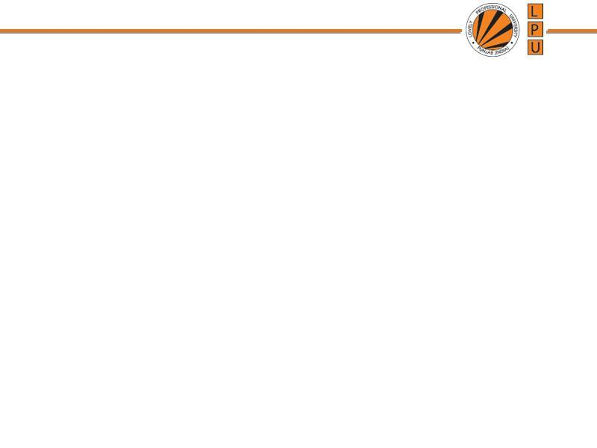
Memory Management

Slide 2
Memory Management
Memory management is one of the most important functions of an operating system. The working of a computer system majorly depends on two components: Memory and CPU.
As far as the memory of a system is concerned there are three important criteria which an operating system has to take care.
Size– More the memory is available more it is easy to solve complex problems.
Access time– Less access time is desirable to execute the programs.
Per unit Cost-Per unit cost of the memory should be less.
Notes:
Cache memory is a small, fast storage located between the CPU and RAM that holds frequently used data and instructions to speed up access times

Slide 3
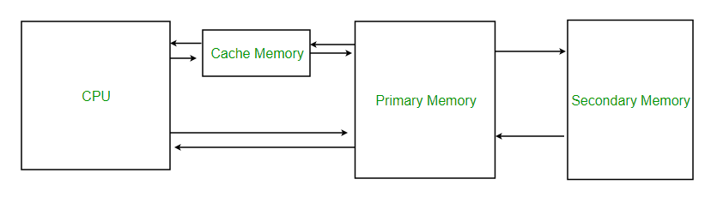
Memory

Slide 4
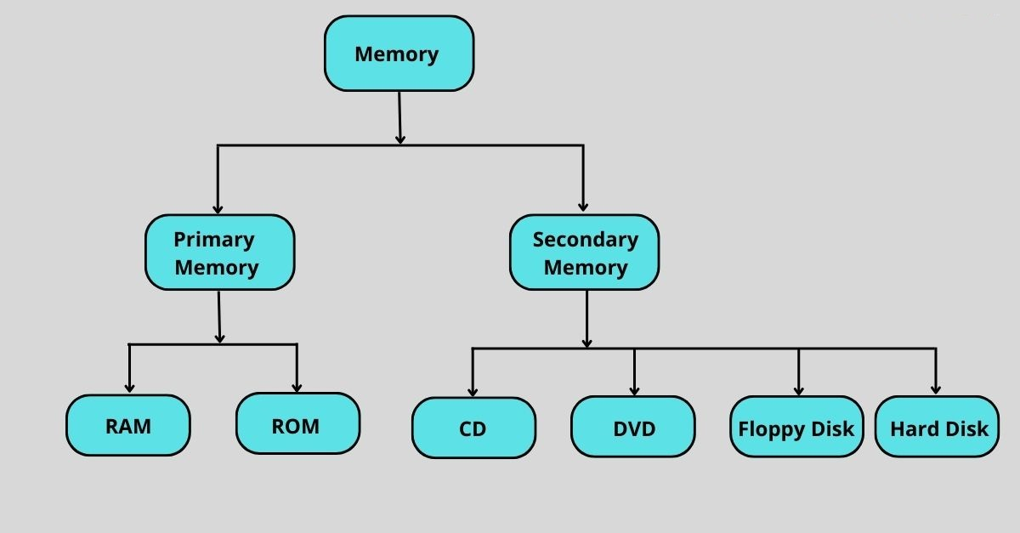

Slide 5
Memory
Computer has 2 types of memory:
a)Main Memory: temporarily stores data and instructions executed by the computer. CPU retrieve instructions from main memory and executes it.
b) Secondary Memory: directly is not accessed by CPU
Memory addresses:
1.Absolute address: It gives the exact location of a byte or instruction in the RAM.
Example: If a variable is stored at address 5000, then 5000 is its absolute address.
2. Relative address: Location of byte in RAM is obtained by adding displacement to base address.
e.g. base address: 2000, displacement: 2
Relative address : 2000+2=2002
Example: Think of memory like a long street of houses 🏠 (each with a unique number).The base address is the starting house number. The displacement tells you how many houses ahead you need to go.
Notes:
Displacement (also called offset)
It is the distance or difference added to a base address to find the exact memory location of data or an instruction

Slide 6
The actual locations in main memory (RAM) where data and instructions are stored.
Generated after the address binding process by the MMU (Memory Management Unit).
Logical and Physical Address
1.Logical Address – An address generated by the CPU during program execution is referred to as the logical address. The set of all logical addresses comprise the Logical Address Space. These addresses are not actual physical locations in RAM — they need to be mapped to physical addresses.
Example: When your program uses variables like x, y, or an array, the compiler assigns them logical addresses (e.g., 0, 1, 2, …).
2.Physical Address – The actual locations in main memory (RAM) where data and instructions are stored. Generated after the address binding process by the MMU (Memory Management Unit).
Example:If the base address of the program in RAM is 2000, and the logical address is 50,then Physical Address = 2000 + 50 = 2050

Slide 7
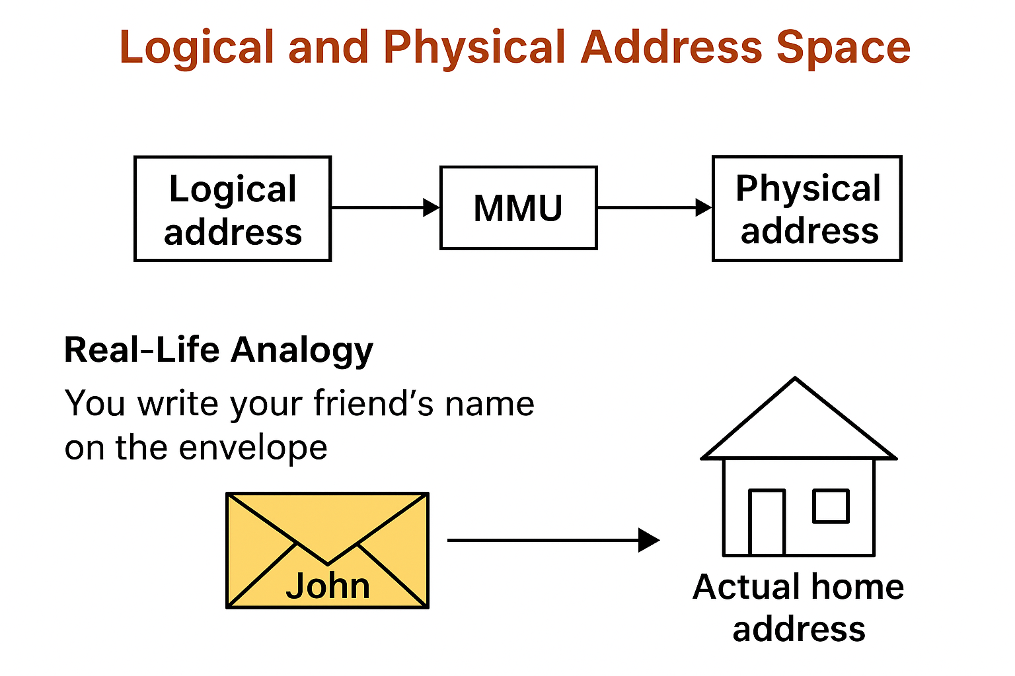

Slide 8
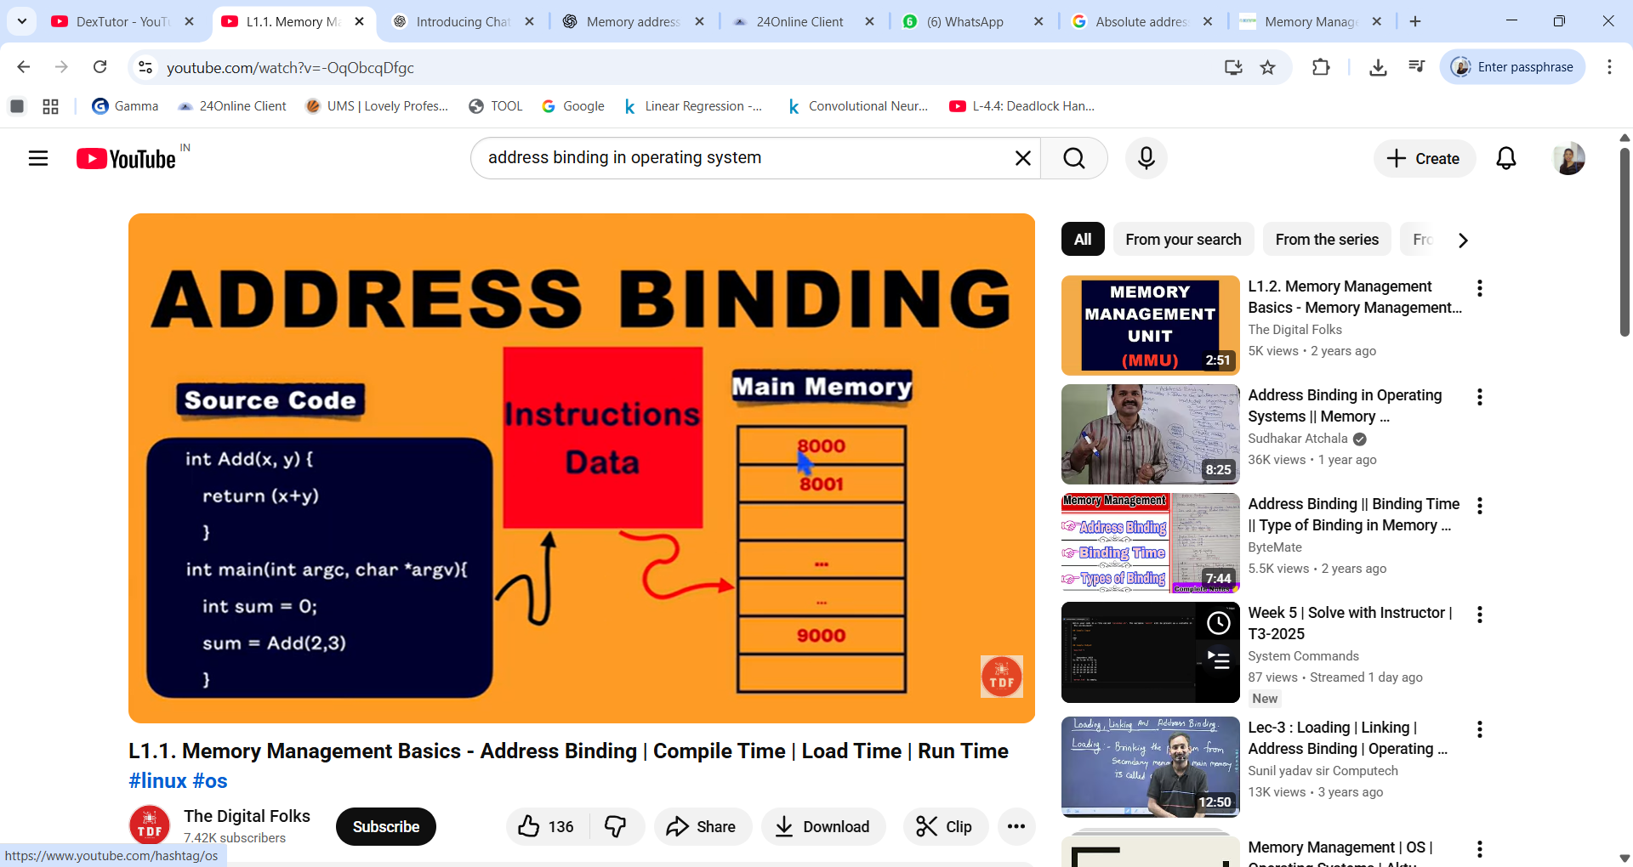

Slide 9
Address Binding
Address binding is the process of mapping a program’s logical (virtual) addresses to physical (real) addresses in memory.
The address binding is done in the following ways:
1.Compile Time– If the location of the process in the main memory is known at the compile time, then absolute code can be generated.
2.Load Time– If the address is not known at the compile time, then the relocatable address is generated by the compiler and binding is delayed till load time.
3. Execution Time– This type of binding is done when process is moving from one memory location to another during run-time.
Notes:
Absolute code is the type of machine code that contains actual physical (absolute) memory addresses for all instructions and data.
That means:
Every instruction in the program directly refers to the real address in memory (like 5000, 2002, etc.).
The program must always be loaded at that exact address in RAM — otherwise, it won’t work correctly
A relocatable address tells where something is relative to the beginning of the program,
not where it will actually be in memory.

Slide 10
Resident Monitor System
A part of O.S resides in Main Memory
To execute any program it is required to be bought into Main Memory
CPU can not directly access program from Main Memory.
e.g. : Device drivers for printer, load when
required.
Memory is divided into 2 parts:
Memory portion for O.S
Memory portion for User Program
RAM MEMORY
Resident memory (where OS files resides)
Transient memory (where user program resides)

Slide 11
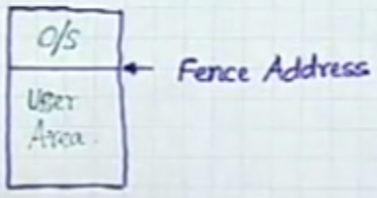
Fencing / Fence Address
There could be a situation:
User try to access O.S area
Try to write into O.S area
Solution:
Fencing → Fence Address
If user prog. Address < fence address: Interrupt → user is accessing OS area which is not permitted
If user prog. Address > fence address: Valid address, user is permitted to access.
May lead to system crash

Slide 12
Fencing / Fence Address
How to put Fence Address: Can be placed in hardware
When user tries to access memory, memory address is compared with Fence Address.
Methods of Comparison:
a) Software: Write a program to Implement comparison
b) Hardware: Fence address could be built in hardware.
If Fence address could be built in hardware : Address is static
Problem: When system needs updation
Solution: Consider Fence Register , Reloaded when system is updated:
Example:
Memory range: 0 – 9999
OS occupies: 0 – 4999
Fence address = 5000
Now:
A user program can access 5000–9999 only.

Slide 13
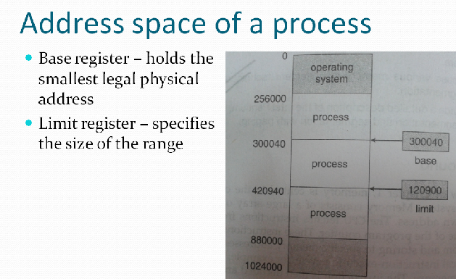

Slide 14
Address spaces of a Process
1.Base Address
Stores the starting physical address where the process is loaded in main memory (RAM).
It is added to every logical (virtual) address generated by the process to get the physical address.
✅ Example:Base Register = 100040
Logical Address = 70000
Then: Physical Address = Base + Logical = 100040 + 70000 = 170040
2.Limit Address
It defines the maximum size(range) of the process’s address space.
It ensures process do not access memory beyond its allocated range.

Slide 15
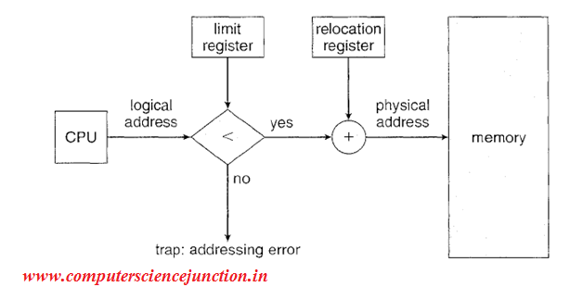
Notes:
The Relocation Register (or Base Register) is a hardware register used by the CPU to map logical addresses (used by a program) to physical addresses (actual addresses in RAM).
It holds the starting physical address of the process in memory.
But when the program is loaded into main memory, it can be placed anywhere — not necessarily starting from 0.
The relocation register ensures that:
Every logical address generated by the CPU is automatically shifted to the correct physical location in RAM.

Slide 16
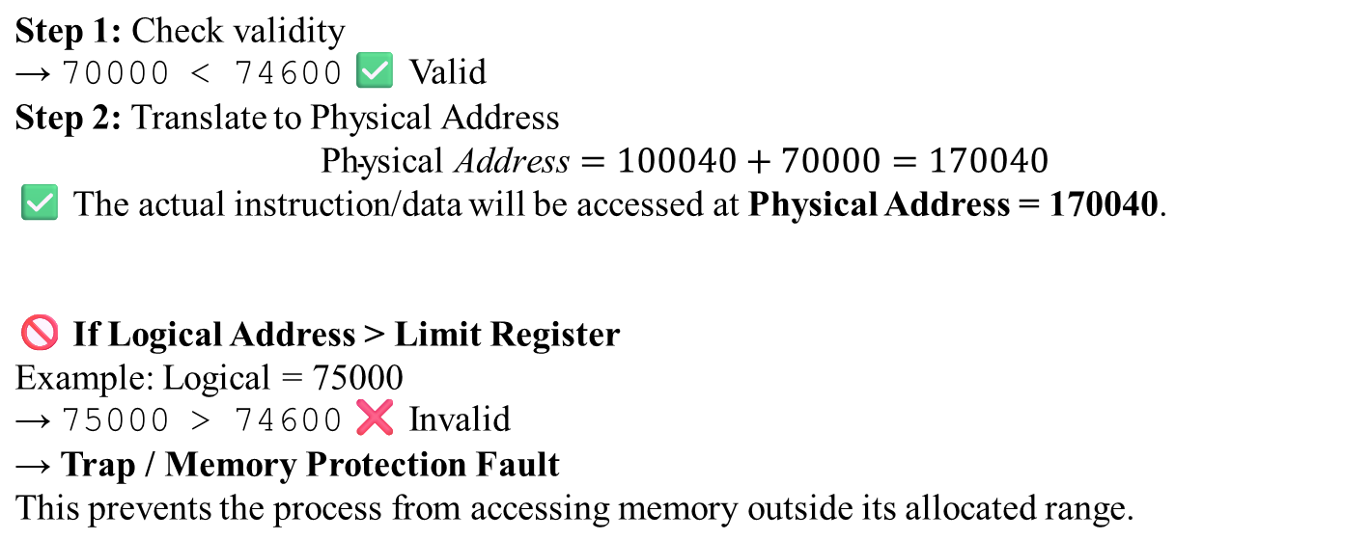
Example
Parameter | Value
Relocation Register (Base) | 100040
Limit Register | 74600
Logical Address | 70000

Slide 17
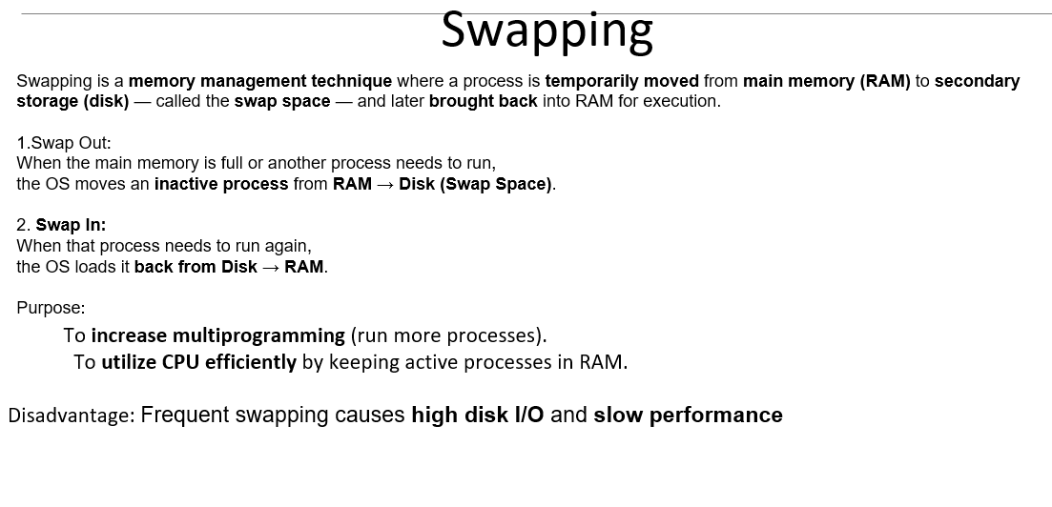
Swapping is a memory management technique where a process is temporarily moved from main memory (RAM) to secondary storage (disk) — called the swap space — and later brought back into RAM for execution.
1.Swap Out:
When the main memory is full or another process needs to run,
the OS moves an inactive process from RAM → Disk (Swap Space).
2. Swap In:
When that process needs to run again,
the OS loads it back from Disk → RAM.
Purpose:

Slide 18
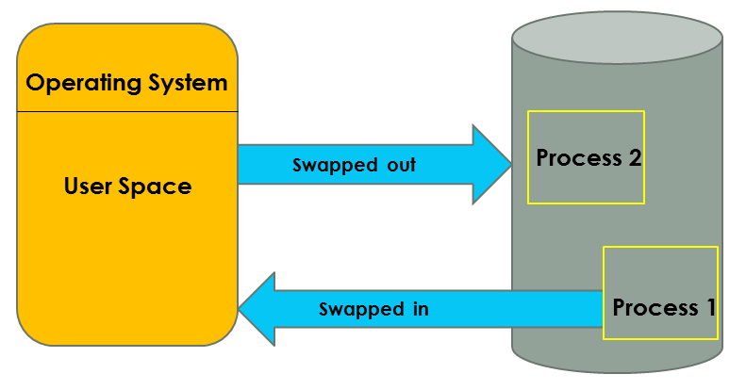

Slide 19
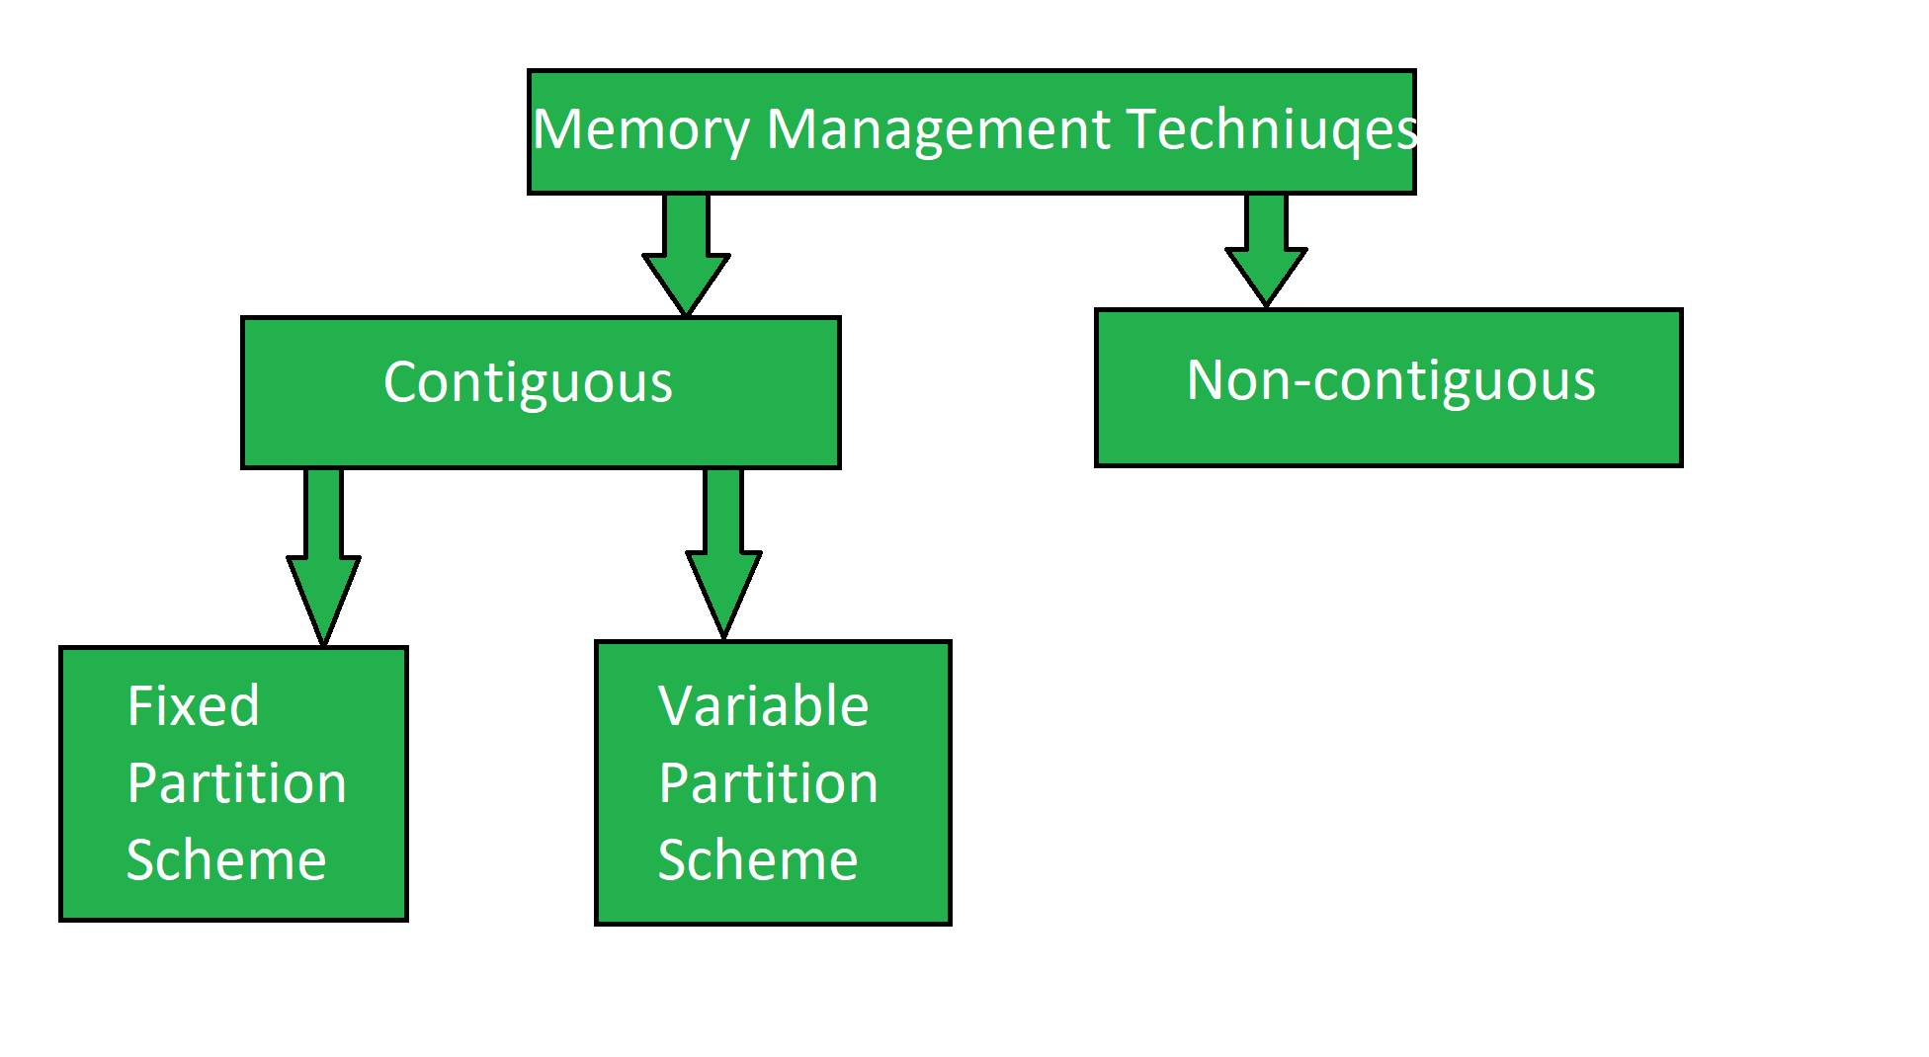

Slide 20
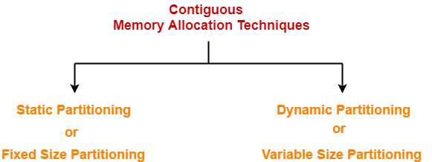
Contiguous memory allocation
Contiguous memory allocation is a classical memory allocation model that assigns process in consecutive memory blocks (that is, memory blocks having consecutive addresses).
Allocation can be done using fixed-size partitions or variable-size partitions, with different strategies like first-fit, best-fit, or worst-fit used to manage the available memory.

Slide 21
Fixed partitioning
Memory is divided into fixed-size partitions at system startup. Each partition can hold exactly one process. Each process is loaded into the first suitable partition available.
Partition Allocation Algorithms
Method | Description | Example (Partitions: 100KB, 200KB, 300KB, 400KB) | Process Size = 180KB
🟩 First Fit | Allocates the first partition that is large enough. | ✅ 200KB partition chosen (first suitable)
🟦 Best Fit | Allocates the smallest partition that fits the process. | ✅ 200KB partition chosen (least waste)
🟥 Worst Fit | Allocates the largest available partition to the process. | ✅ 400KB partition chosen (most waste)
Advantages:
Simple to implement
Disadvantages:
Internal Fragmentation (unused space within partitions)
Fixed number of processes

